Slide 1
R Clinic
Session 5:
A basic introduction to multivariate statistics

Slide 2
REMINDER: write down your email address for access to the Dropbox with slides and code.
We will be in this room until beginning of August

Slide 3
Aim of snippet sessions
A brief overview of a topic in R
A quick refresher
Provide a ‘jumping off point’ to get you started in a new area of R coding – not statistical guidance
Suggestions welcome!

Slide 4
Multivariate statistics
Group of analysis methods that deal with observations made on many variables

Slide 5
Why do we use multivariate statistics?
Describing your data
Similarities and differences between observations/variables
Summarising your data
Reduce the number of variables or ‘dimensionality’ of data
Classification
Identify clusters of similar observations

Slide 6

I’m an ecologist…
But these techniques can be applied in any discipline

Slide 7
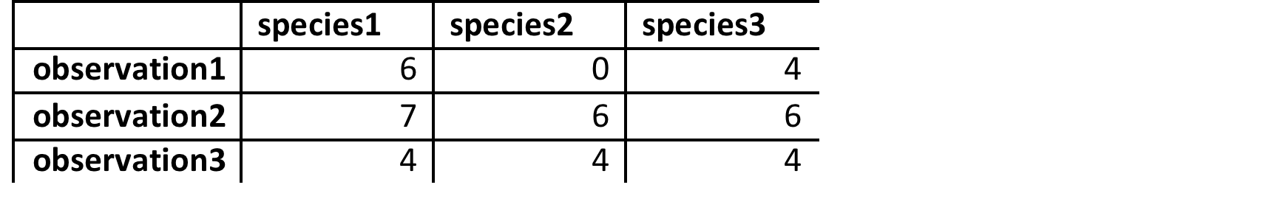

Formatting data
variables
cases
variables
cases

Slide 8
Ordination
Presents variation in conceptualised ‘data cloud’
Seeks to describe shape and dispersion of ‘cloud’
Similar observations plotted close together
Dissimilar observations plotted further apart

Slide 9
Axis 1 (eigenvector 1) – Line through ‘data cloud’ that explains the greatest amount of variance.
Will always go through central point

Slide 10
Axis 1 (eigenvector 1) – Line through ‘data cloud’ that explains the greatest amount of variance.
Will always go through central point
Axis 2 (eigenvector 2) – Orthogonal to (uncorrelated with) Axis 1 that best explains the next greatest amount of variance.
Also through centroid point

Slide 11
Principle component analysis (PCA)
More commonly used ordination technique
Assumes normal distribution of quantitative data
Detects linear relationships using Euclidean distance measures
Generally inappropriate for raw species abundance data
Though transformations can be employed

Slide 12
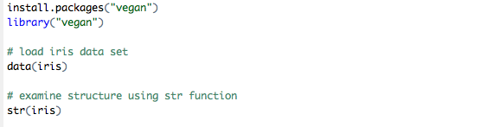
Many packages to carry out ordination – We’ll use vegan here

Slide 13
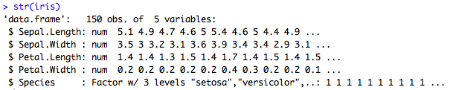
Many packages to carry out ordination – We’ll use vegan here
The first four variables are continuous, we’ll use these for the PCA
‘Species’ can be used to help explain the analysis afterwards

Slide 14
Perform PCA
PCA function in vegan is ‘rda’
(RDA analysis without constraint – we’ll come to that later)
Employ the argument ‘scale’ to allow more appropriate comparison of variables

Slide 15
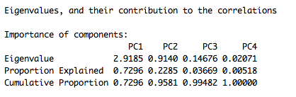
PCA output

Slide 16
PCA output
Each axis (or eigenvector) is referred to as a Principle Component

Slide 17
PCA output
Eigenvalues – How spread out is the data along this eigenvector axis?

Slide 18
PCA output
Proportion of variation in the data explained by each Principle Component (axis or eigenvector)

Slide 19
PCA output
Cumulative proportion of variance explained

Slide 20
Constrained Ordination
“Associates two or more data sets in the ordination process”
Can extract structures in one data set that are related to structures in another data set.
Often (but not always!) have a response matrix (e.g. species) and an explanatory matrix (e.g. environmental factors)

Slide 21
Redundancy analysis (RDA)
Combines PCA with regression analysis
rda(response.matrix ~ explanatory variable, explanatory matrix)

Slide 22
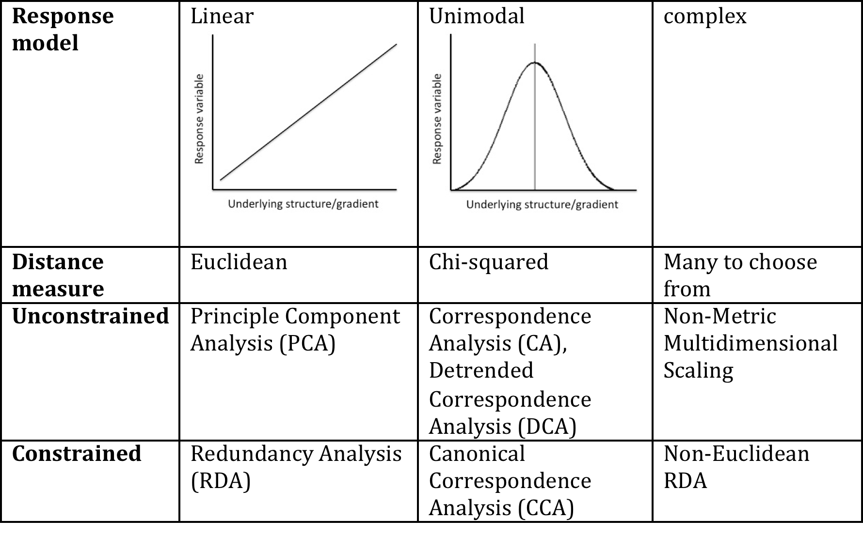
Which ordination method should I use?
This is not an exhaustive list…

Slide 23
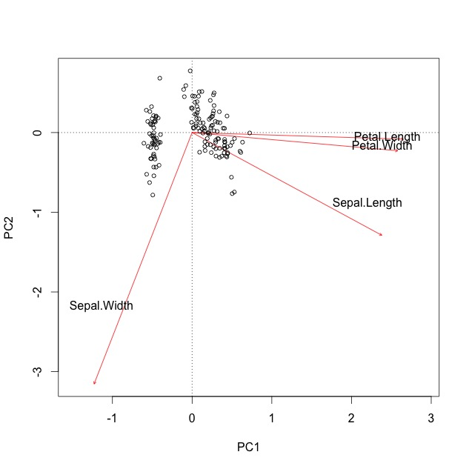
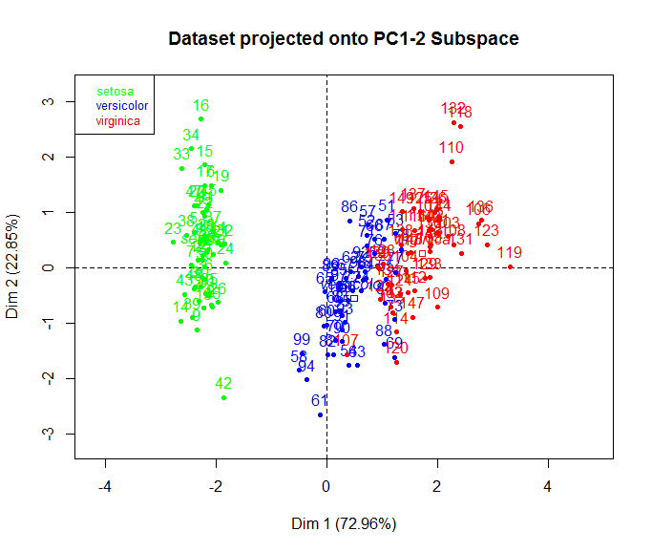
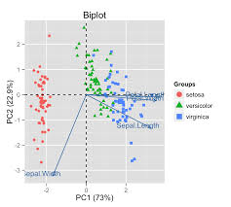
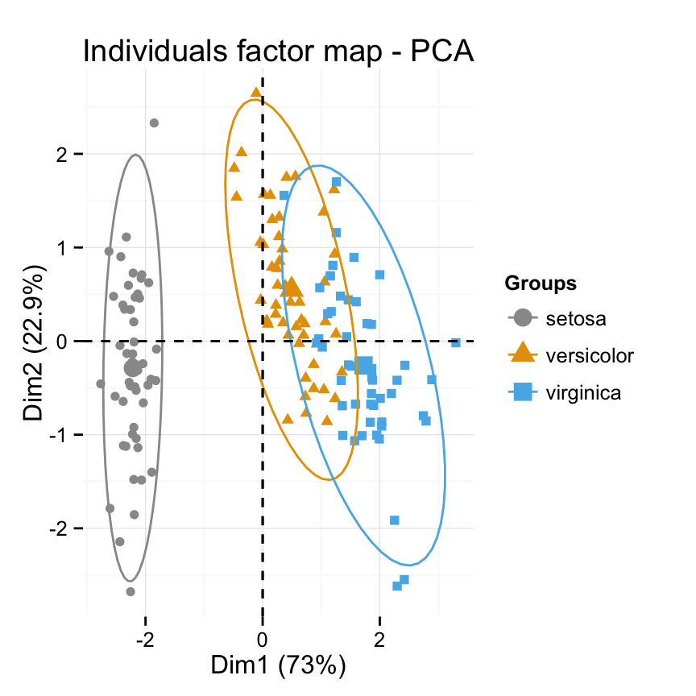
Biplots
Basic R function biplot(model.name)
There are many, many ways of displaying ordinations
Will be have to be a whole snippet session

Slide 24
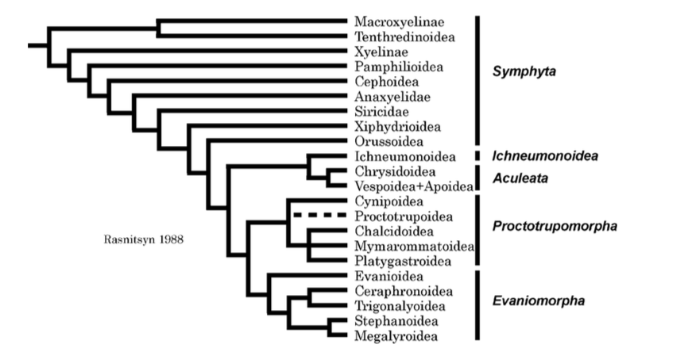
Cluster analysis
Identify ‘clusters’ of similar objects or observations
Again, there are many methods to choose from depending on your data and/or question

Slide 25
Things to think about
Know your data!
Methods are based on assumptions. E.g. type of data, data distribution etc..
Transformations and standardising may be useful
Multivariate statistics is a very broad area
Different methods suit different data sets better
Lots of information online

Slide 26
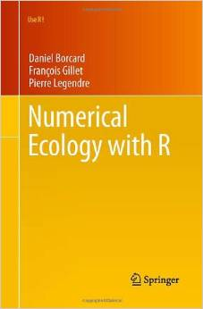

Slide 27
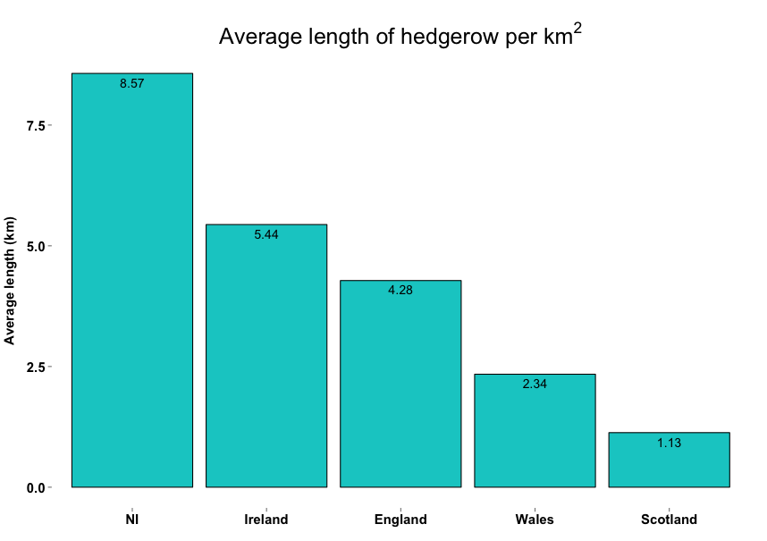
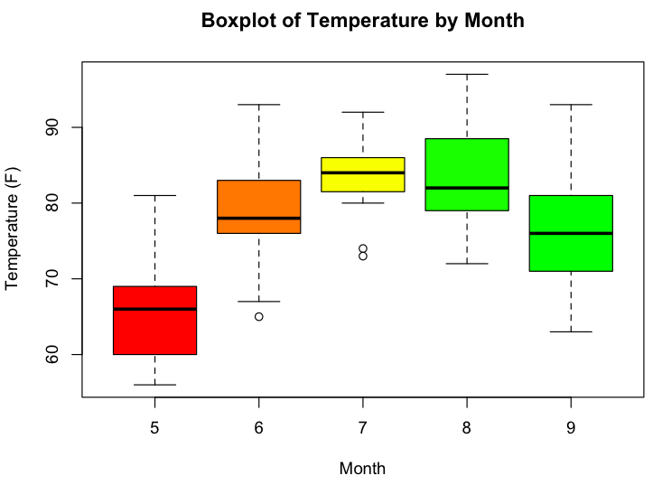
Next week…
Beginner's visualization in R

